Slide 1

BREAKOUT BALL Garima Arora PC43 Atul Kumar PC44 Jay Shrivastava Pc47 Under guidance of Prof. Mrunal Annadate School of Electronics & Communications

Slide 2
INDEX
Introduction
2. Aim
3. Objective
4. Project Stages
5. Game Terminal
6. GamePlay Class
7. Map Generator Class
8. Expected Outcome

Slide 3
INTRODUCTION
Software used : Eclipse IDE
Java is widely used by game development companies .
Breakout Ball is game in which a layer of bricks lines the top of the screen and the goal is to destroy them all. A ball moves straight around the screen, bouncing off the top and two sides of the screen. When a brick is hit, the ball bounces back and the brick is destroyed.

Slide 4
AIM
To Create a Breakout Ball game in Java using concepts of classes , Oops, GUI.
In an java game, the player will be able to break statically located bricks placed on the top of the screen using a ball. The ball keeps on moving from top to bottom . A paddle at the bottom can be used to change the direction of the ball touching the ground . If ball touches the ground , the player will loose the game but if player breaks all the bricks then the player is declared as winner.

Slide 5
OBJECTIVE
Game should start by pressing the arrow Key.
Movement of paddle through left and right arrow keys.
Game should end once ball touches the ground.
5 points assigned after breaking each brick.
Once game ends , option to restart should be available.

Slide 6
PROJECT STAGES:
Window Terminal frame
Background Setting
Designing Gameplay
Implementing Actions

Slide 7
GAME TERMINAL:
Creating a Main class.
Import Java Swing dependency.
Creating JFrame object to implement the GUI functionality
Design the window terminal.

Slide 8
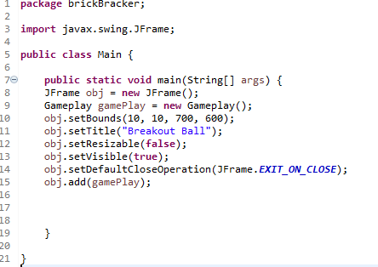
THE J FRAME CLASS
This is the class containing the main() function.
Imported class included:
import javax.swing.JFrame;
We will get a blank frame which will be set up of the game.

Slide 9
GamePlay Class :
Creating a Gameplay class.
Import Java AWT and Swing dependencies.
Implementing KeyListner and ActionListner interfaces.
Designing background template.
Implement the code for ball positioning & paddle.

Slide 10
Gameplay Class Classes Involved
Important Classes
setFocusable(Boolean_expression);
setFocusTraversalKeysEnabled(Boolean_expression);
paint()
fillRect(int x, int y, int Width, int Height);
Imported Class:
import java.awt.Color
import java.awt.event.KeyListner
import java.awt.event.ActionListner
import javax.swing.Timer
import.java.awt.Graphics

Slide 11
MAP GENERATOR CLASS
Creating a Map Generator class.
Import Java AWT dependency.
Design the bricks using Graphics2D.
Implement the code for the bricks to disappear.
Implement the code for calculating the score in the 'Gameplay' class

Slide 12
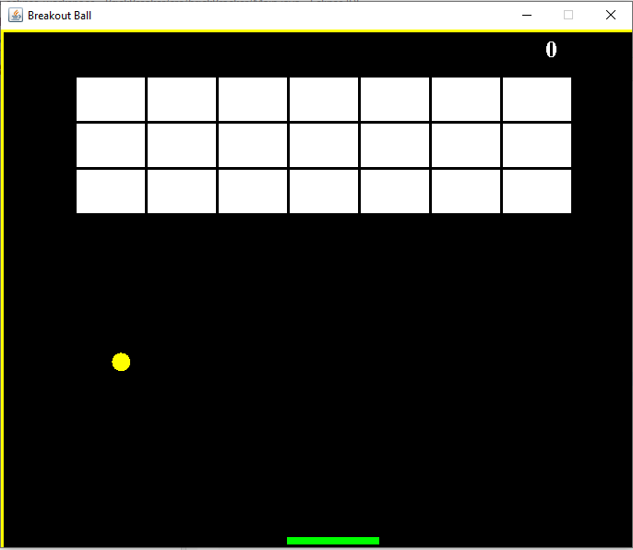
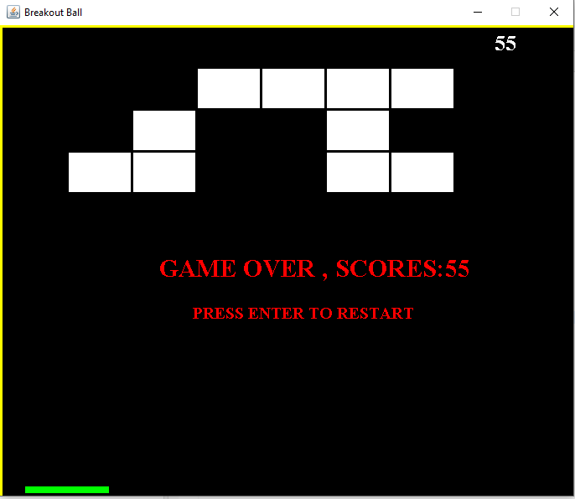
Expected Outcome:

Slide 13
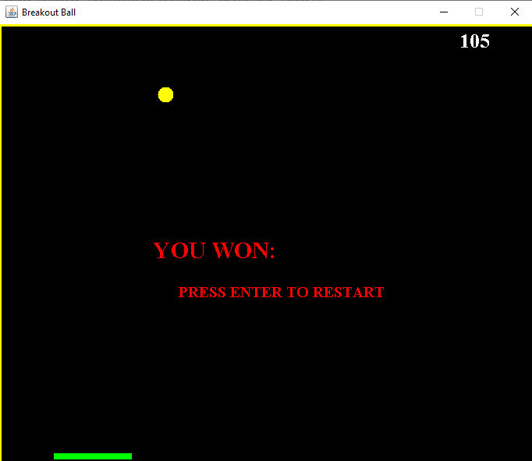
Expected Outcome:

Slide 14
REFERENCES
https://www.tutorialspoint.com/java/index.htm
https://www.javatpoint.com/java-tutorial
https://www.codecademy.com/

Slide 15
THANK YOU!

